Slide 1
CMSC 389N
Please try and sit near the front!

Slide 2
Agenda
About Me
Course Overview
Course Requirements

Slide 3
Goal For Today
Everyone should be on gitlab, and have all necessary software installed, and familiar with the steps to grab course materials in this class.

Slide 4
About Me

Slide 5

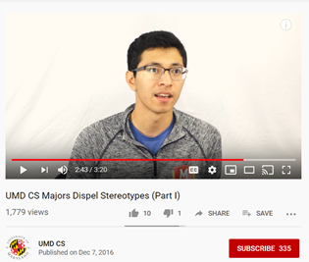
About Me

Slide 6
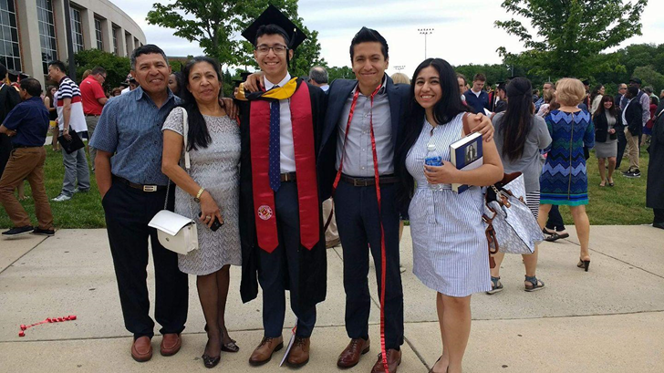
About Me

Slide 7
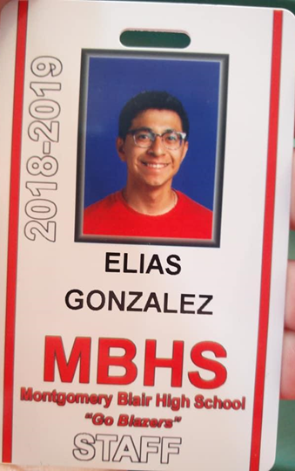
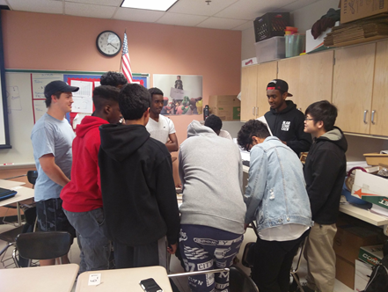
About Me

Slide 8
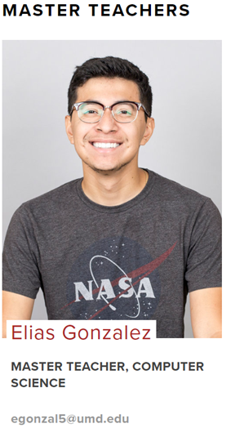
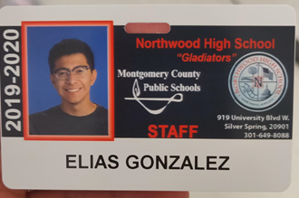
About Me

Slide 9
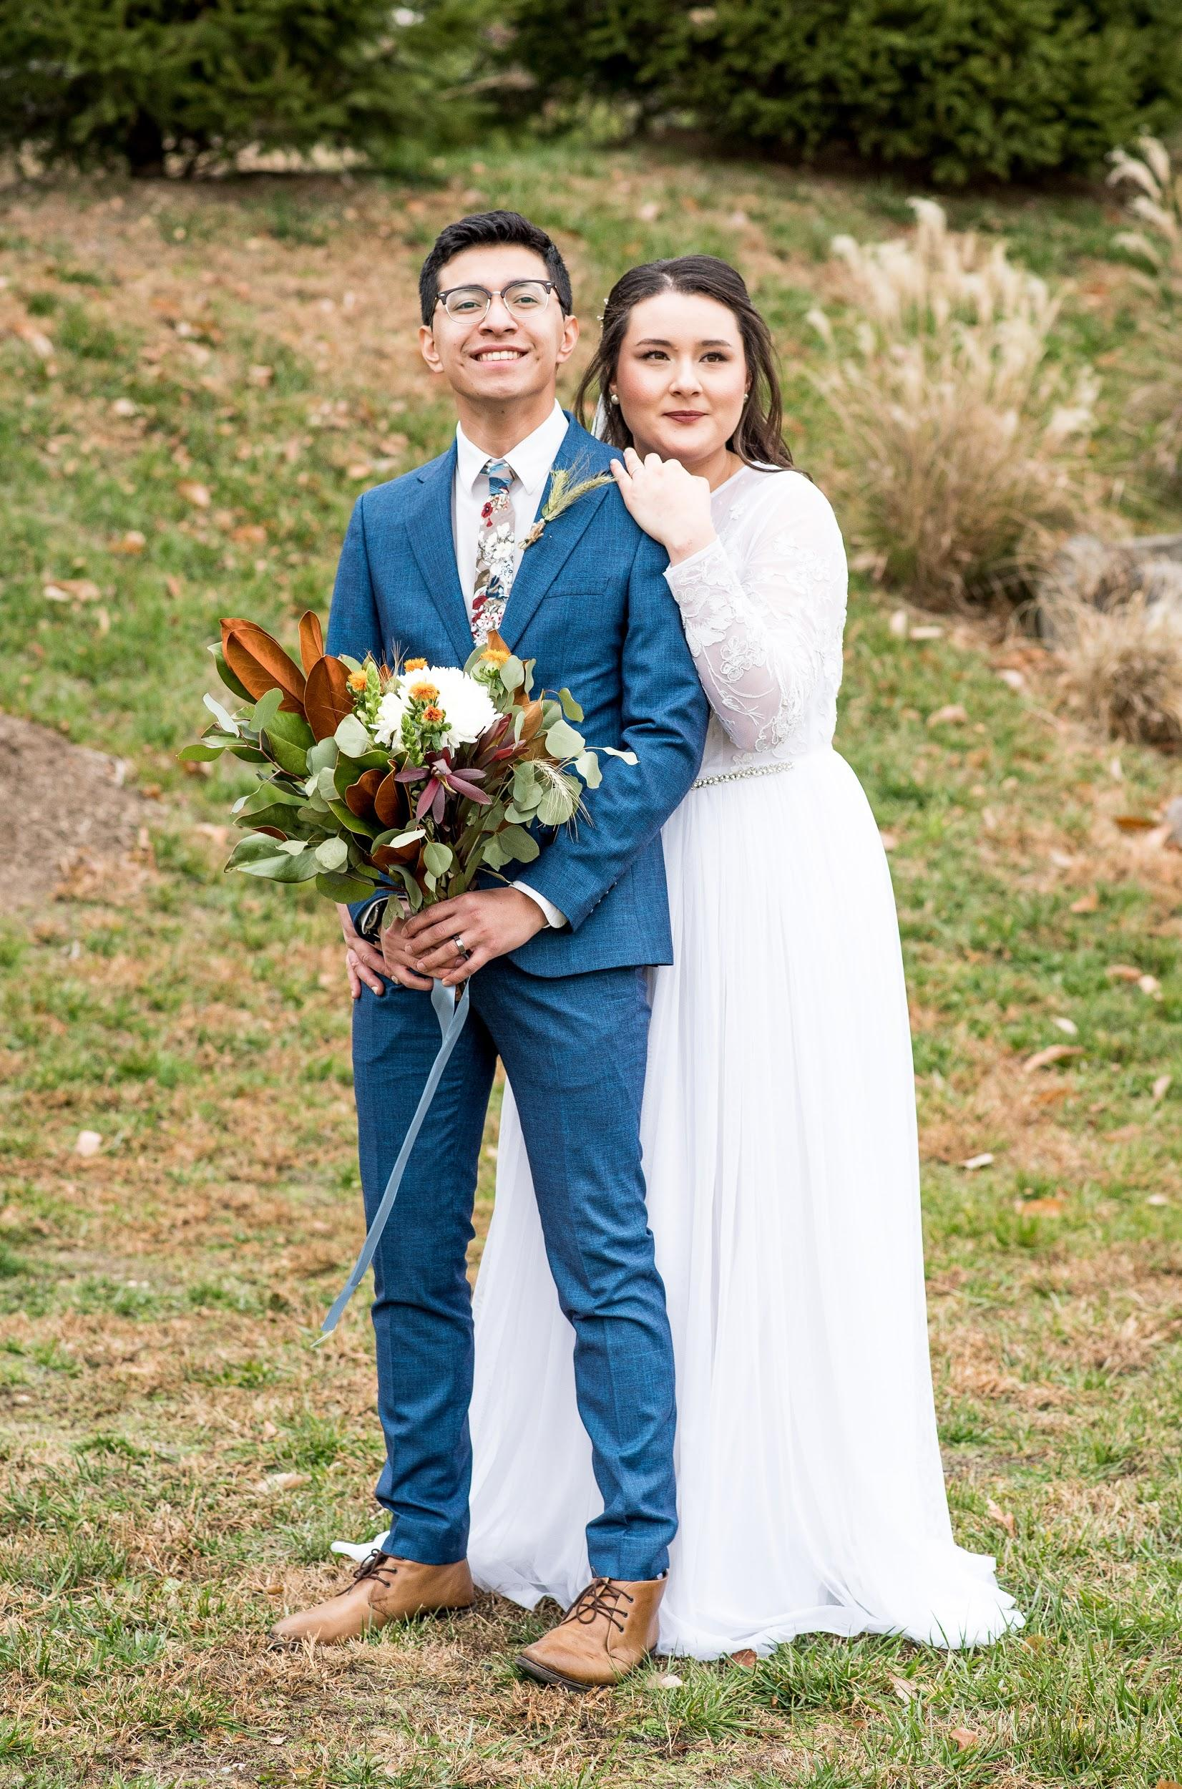
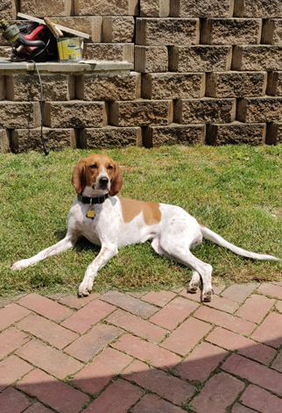


About Me

Slide 10
How to Reach Me
egonzal5@umd.edu
Webpage: egonzal5.github.io/389N
Office: IRB 2224
Office Hours: Mon/Wed: 12pm - 2pm, Tuesday: 1pm - 3pm
Piazza: piazza.com/terpmail.umd/spring2020/0101
TA Office Hours Will be Posted on Piazza

Slide 11
Course Overview
Exercise & Projects: 65%
Midterm #1: 15%
Final: 20%

Slide 12
Downloads Necessary For the Course
Node
Visual Studio
Git
Gitbash (If you are on Windows)
Do Git and Gitbash now!

Slide 13
Downloads Necessary for the Course (Pt.2)
Go to gitlab.cs.umd.edu and log in using UMD CAS.
Follow my instructions to add your ssh key!

Slide 14
Git ‘er done
We will be using git to access and turn in course materials.

Slide 15
4 Steps DON’T DO IT YET!
Head to gitlab, copy your repository.
git remote add upstream git@gitlab.cs.umd.edu:arasevic/cmsc389Nspring2020-student.git
git pull upstream master
git push origin master

Slide 16
What are we doing here?
Git- An open source, widely used DVCS (Distributed Version Control System).

Slide 17
What are we doing here?
A few key elements:
Upstream
Your repository (repo)
Origin
Master

Slide 18
What are we doing here?
Upstream
(Us instructors)
Master
(on GitLab)

Slide 19
What are we doing here?
Upstream
Master
(on GitLab)
Your Computer
(With Git)
clone git.gitlab@XXXXXXX

Slide 20
What are we doing here?
Upstream
Master
(on GitLab)
Your Computer
(With Git)
git remote add upstream addressHere

Slide 21
What are we doing here?
Upstream
Master
(on GitLab)
git pull upstream master
Your Computer
(With Git)

Slide 22
What are we doing here?
Upstream
Master
(on GitLab)
Your Computer
(With Git)
git push origin master

Slide 23
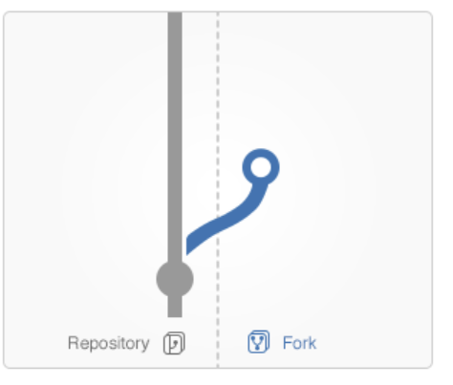
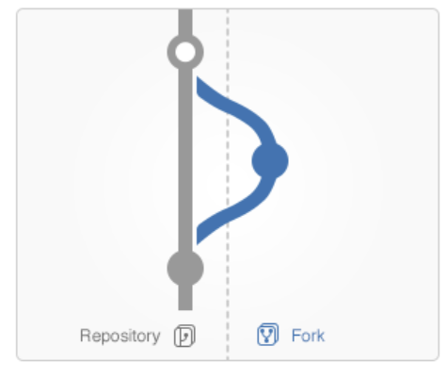
Other Vocab
Fork- Making a copy of a branch and allowing you to make changes freely
Branch- The stream you create by forking
Merge- Merges the stream you forked back into the master

Slide 24
4 Steps
Head to gitlab, copy your repository.
git remote add upstream git@gitlab.cs.umd.edu:arasevic/cmsc389Nspring2020-student.git
git pull upstream master
git push origin master

Slide 25
WTWAW (What To Walk Away With)
Two things:
Make sure you have logged into GitLab
Be able to explain the steps for connecting to our upstream and retrieving the files

